Slide 1
Global Healthcare Data ETL & Analysis CLI
Automating the collection, transformation, and analysis of global health data using a Python-based CLI.

Slide 2
PROBLEM STATEMENT
Public healthcare data is often available in raw, unstructured formats from public APIs and CSV files. This makes it difficult to analyze or use directly for decision-making. Manual processing of such data is time-consuming and prone to errors. There is a lack of automated systems to clean, standardize, and store this data efficiently. Without a reliable ETL process, valuable insights from healthcare data remain inaccessible.

Slide 3
Proposed solution
Develop a CLI-based ETL pipeline to automate the data workflow.
Extract data from public healthcare APIs and CSV files.
Transform the raw data using Python and Pandas to clean, validate, and standardize it.
Load the structured data into a MySQL database with incremental updates.
Provide CLI commands for users to fetch, load, and query data efficiently from the terminal.

Slide 4
Technology Stack
Languages & Tools Used:
Programming Language: Python
Data Manipulation/Transformation: pandas
Database: MySQL, with the mysql.connector library for connectivity.
CLI Framework: argparse for building the command-line interface.
HTTP Requests: requests library for making API calls.
Configuration Management: configparser for reading settings from a
config.ini file.
Logging: The built-in logging module for application logs and error handling.

Slide 5
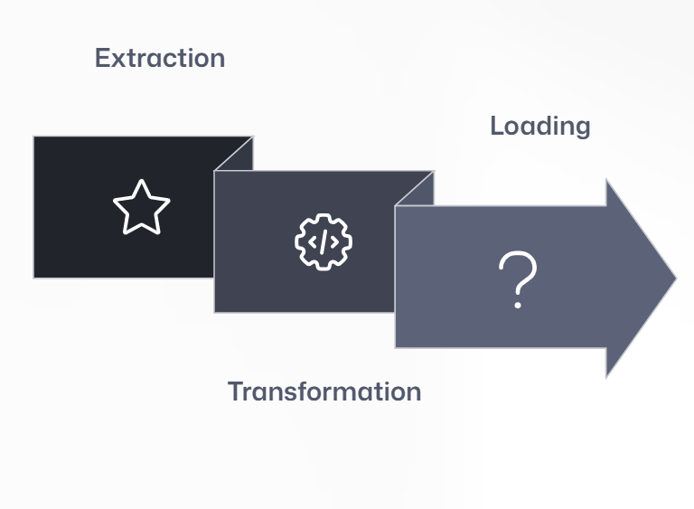
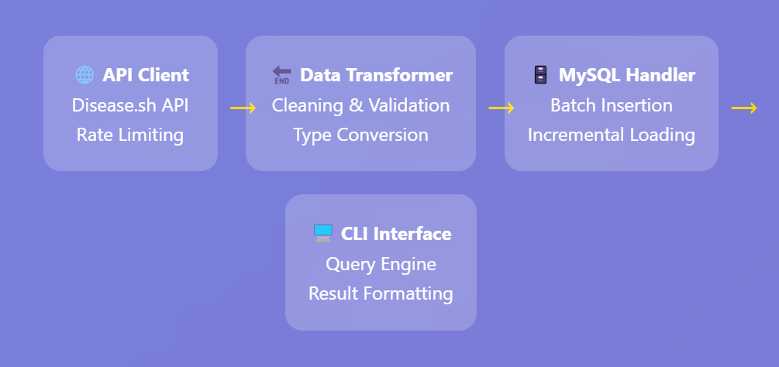
ETL Workflow & System Architecture

Slide 6
CLI Features: Command at Your Fingertips
CLI-Based Interface – Simple command-line access for all operations.
API Integration – Fetches real-time healthcare data from public APIs.
Data Cleaning & Transformation – Handles missing values, formats dates, and removes duplicates.
MySQL Storage – Stores structured data with schema validation and incremental loading.
Analytical Queries – Supports queries like total cases, daily trends, and top N countries.
Schema Management – Auto-creates or drops tables via CLI commands.
Logging & Error Handling – Tracks operations and handles failures gracefully.
CSV Ingestion – Loads vaccination data from CSV files.

Slide 7
Database Schema Overview
daily_cases Table
id: Unique identifier (Primary Key)
country: Country name (VARCHAR)
date: Date of record (DATE)
new_cases: Daily reported cases (INT)
total_cases: Cumulative cases (INT)
vaccination_data Table
id: Unique identifier (Primary Key)
country: Country name (VARCHAR)
date: Date of record (DATE)
daily_vaccinations: Vaccinations on specific day (INT)
people_vaccinated: Total unique vaccinated individuals (INT)
total_vaccinations: Cumulative doses administered (INT)

Slide 8
Core features and functionality
KEY FEATURES
BENEFITS
Command-Line Interface (CLI)
API Data Extraction
Data Cleaning & Transformation
MySQL Integration
Incremental Loading
Query Support
Automation
Data Accuracy
Scalability
Real-World Simulation

Slide 9

challenges
Schema design and validation
Data cleaning and transformation
Unstructured API data
Error handling and logging
Ensuring accurate query results

Slide 10
Conclusion
This project delivers a CLI-based ETL pipeline that automates the processing of healthcare data from APIs and CSVs. It ensures clean, structured storage in MySQL and supports easy data analysis via CLI. The solution improves data accessibility and reflects practical data engineering principles.

Slide 11
Thank you!
Presented By:
Mamidala Harshavardhan

